Slide 1
DATA 603 Platforms for Big Data Processing Class Project - Final Report Used Car Price Prediction
Under the guidance of Prof. Dr. Waleed Youssef
by:
Sai Hitesh Velaga
Niha Reddy Gali
Mercy Subramani

Slide 2
Project Description & Problem Statement:
Our goal is to deal with the trends in prices of Used Cars.
Analyze and Identify Car’s attributes and their with relation with the prices.
Predict the prices with their purchase trends.
And present a solution to deal with higher data loads and performance issues while storing & processing.

Slide 3
Implemented Solution:
Solution that visualizes following insights
Various attributes and their relationship with the price of a car,
Solution that predicts value of used cars that are going to be sold across the Country in future years.
Tools used:
MongoDB Community Server 5.05 along with MongoDB Compass as Back-End Solution.
Used Jupyter Notebook to design solution using Pyspark built on Spark v3.1.2.
Matplot Library for Visualization.

Slide 4
Items that could have been Implemented
Tableau Public for Visualization
A real time solution that predicts the car price as soon as it is listed on a public website(facebook marketplace or craigslist)

Slide 5
Project Process-Flow Diagram
Using Python for Data Cleaning
Performing EDA to extract insights
Loading the data into MongoDB
Using PySpark MLib for building Pipeline
Import dataset from MongoDB server
start Spark from Jupyter Notebook
Using PySpark MLib for building Models
Model Evaluation
Selecting Best Model for the Project

Slide 6
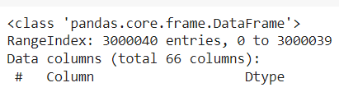
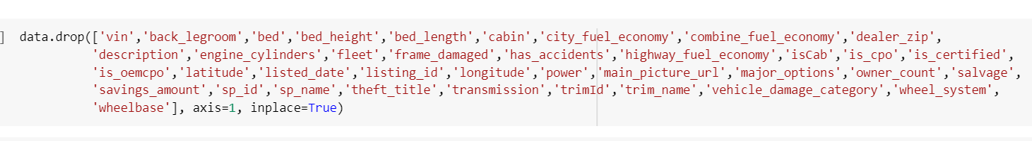
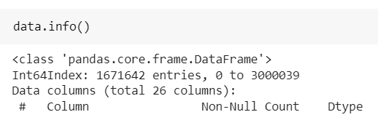
Data Cleaning

Slide 7
Exploratory Data Analysis
Exploratory Data Analysis (EDA) is a type of data analysis that looks for broad patterns in the data. Outliers and data aspects that are unexpected are included in these patterns. In every data analysis, EDA is a crucial initial step
Takes just the most important variables and discards the rest
Outliers, missing values, or human error will be identified
To understand the connections between variables.

Slide 8
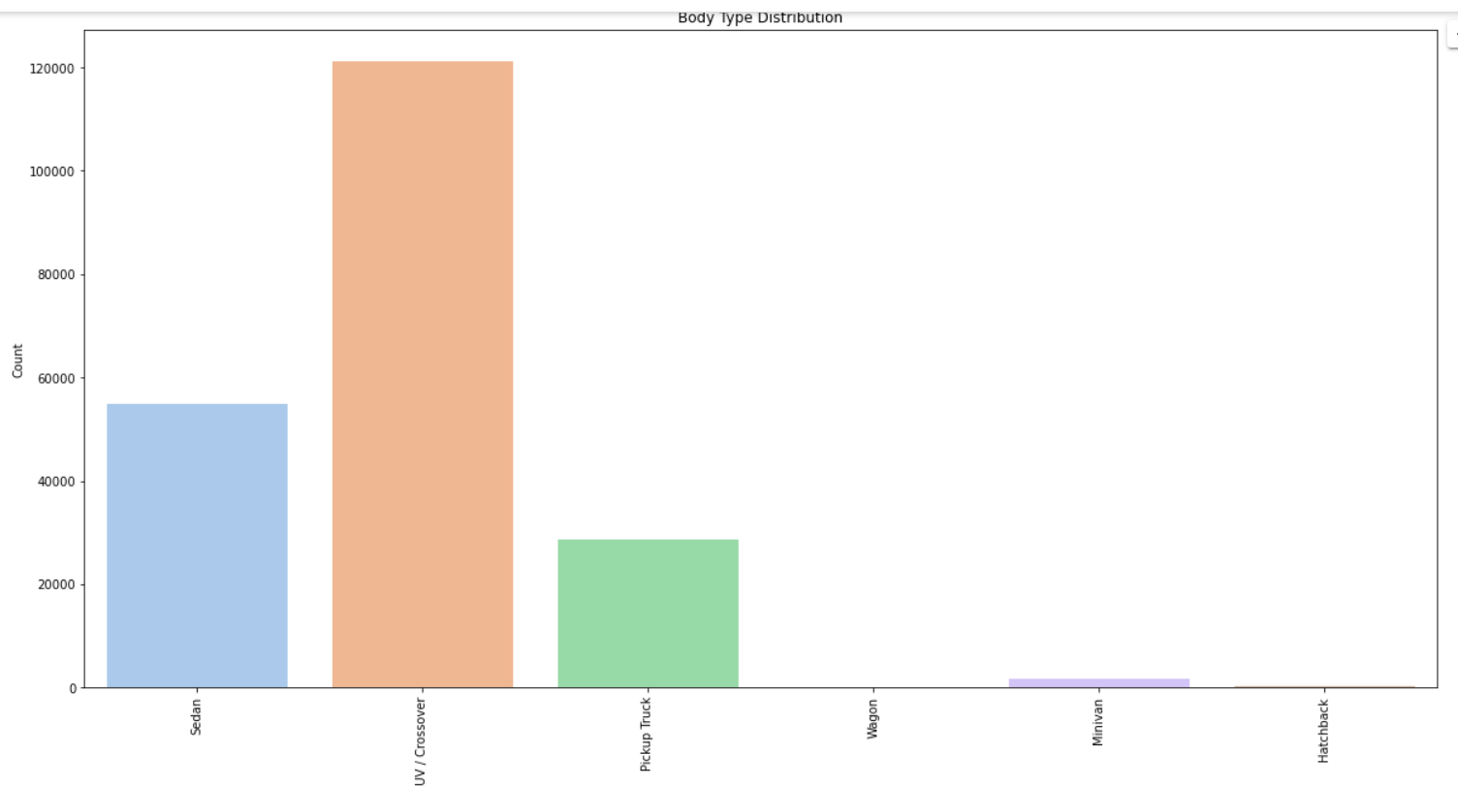

Slide 9
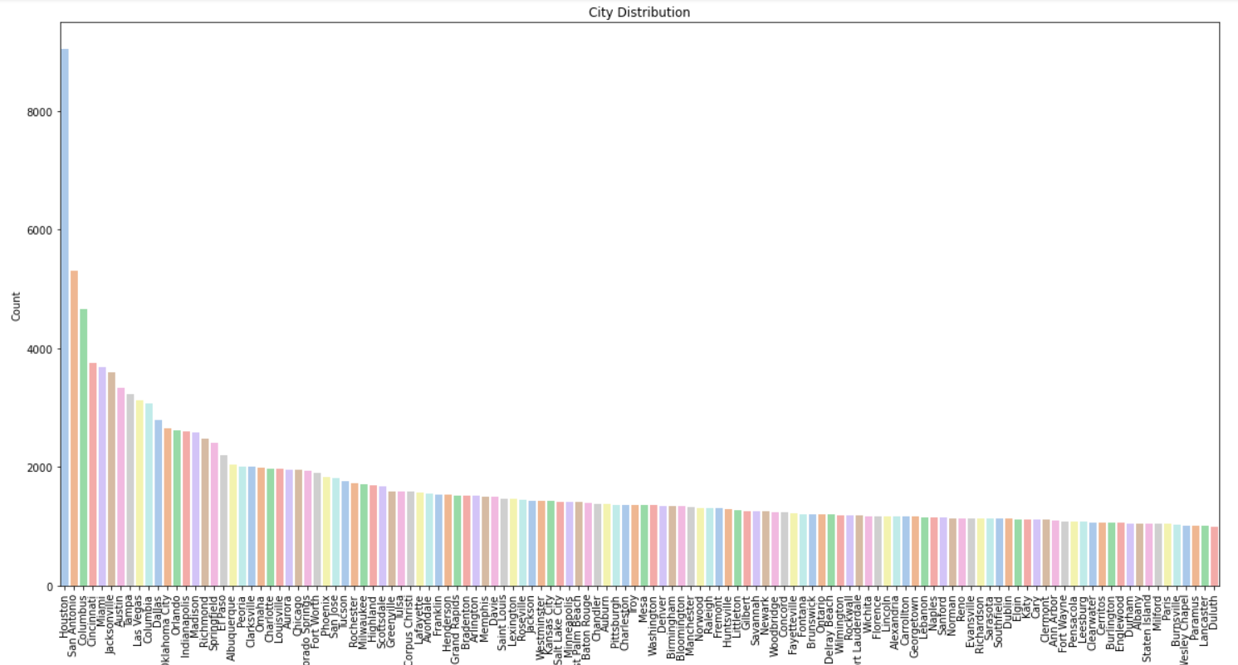

Slide 10
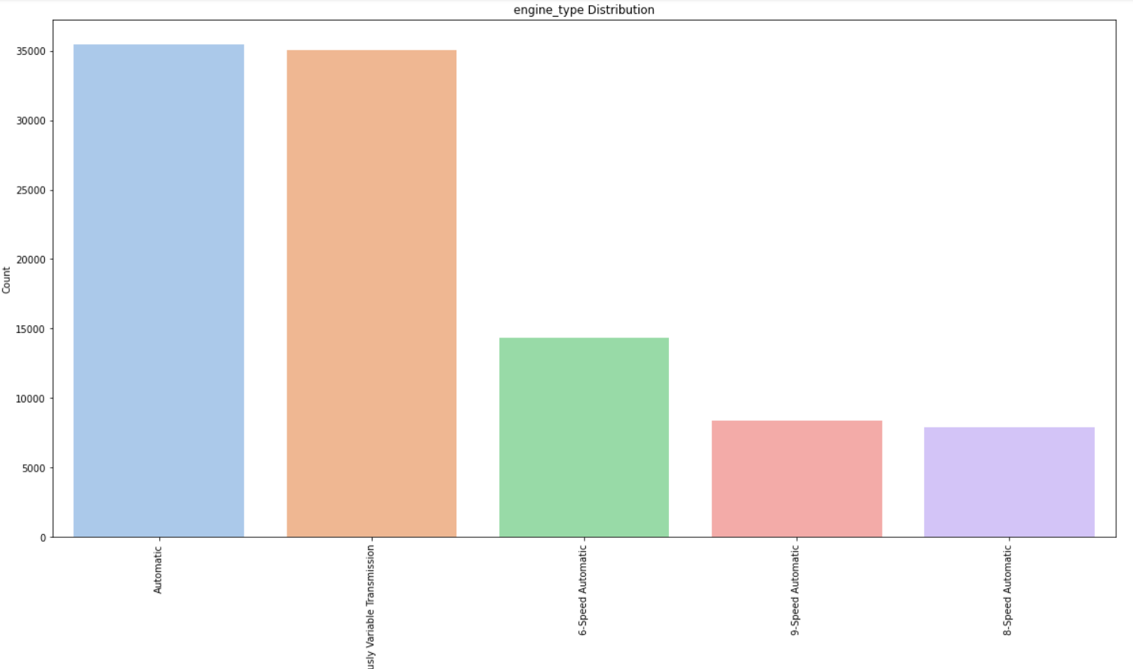

Slide 11
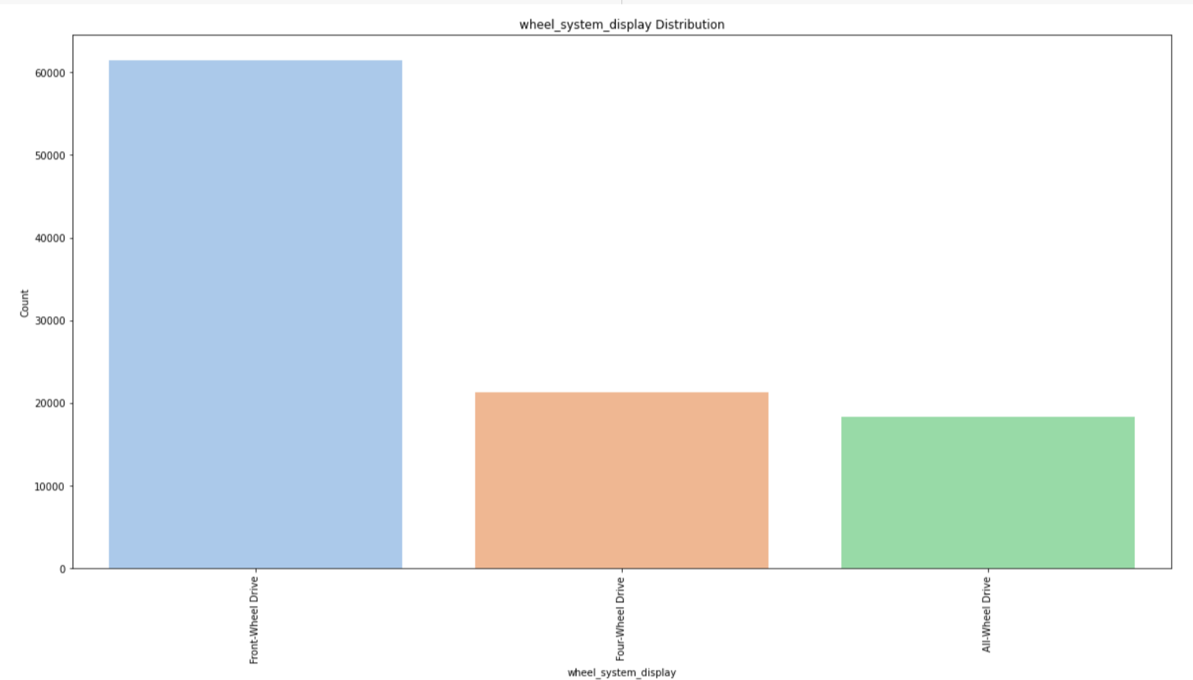

Slide 12
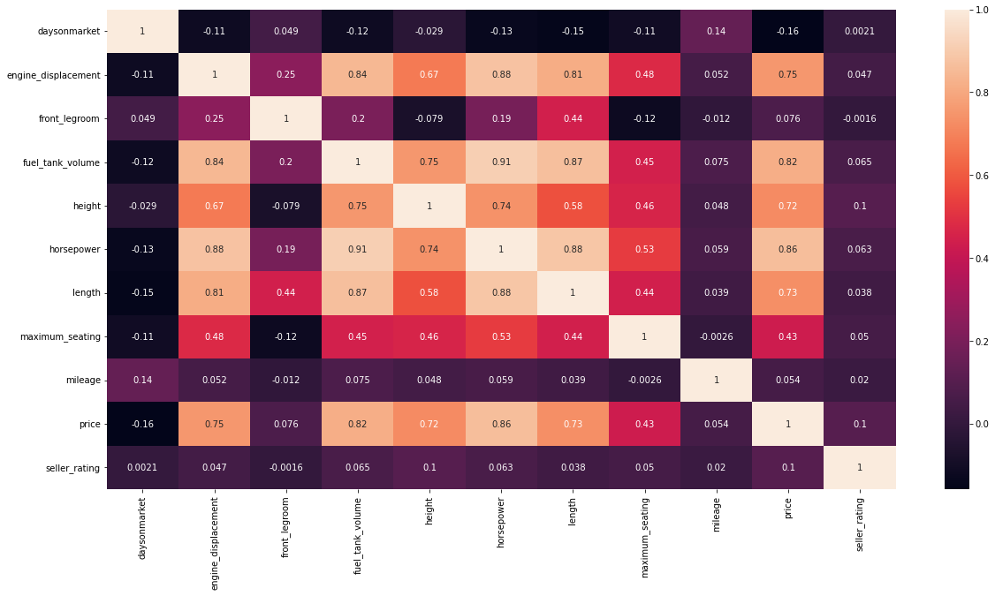

Slide 13
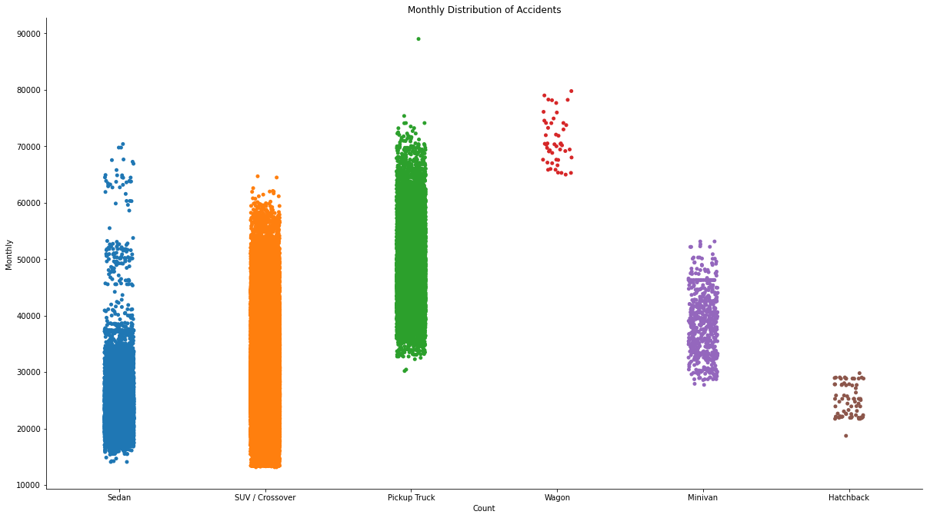

Slide 14
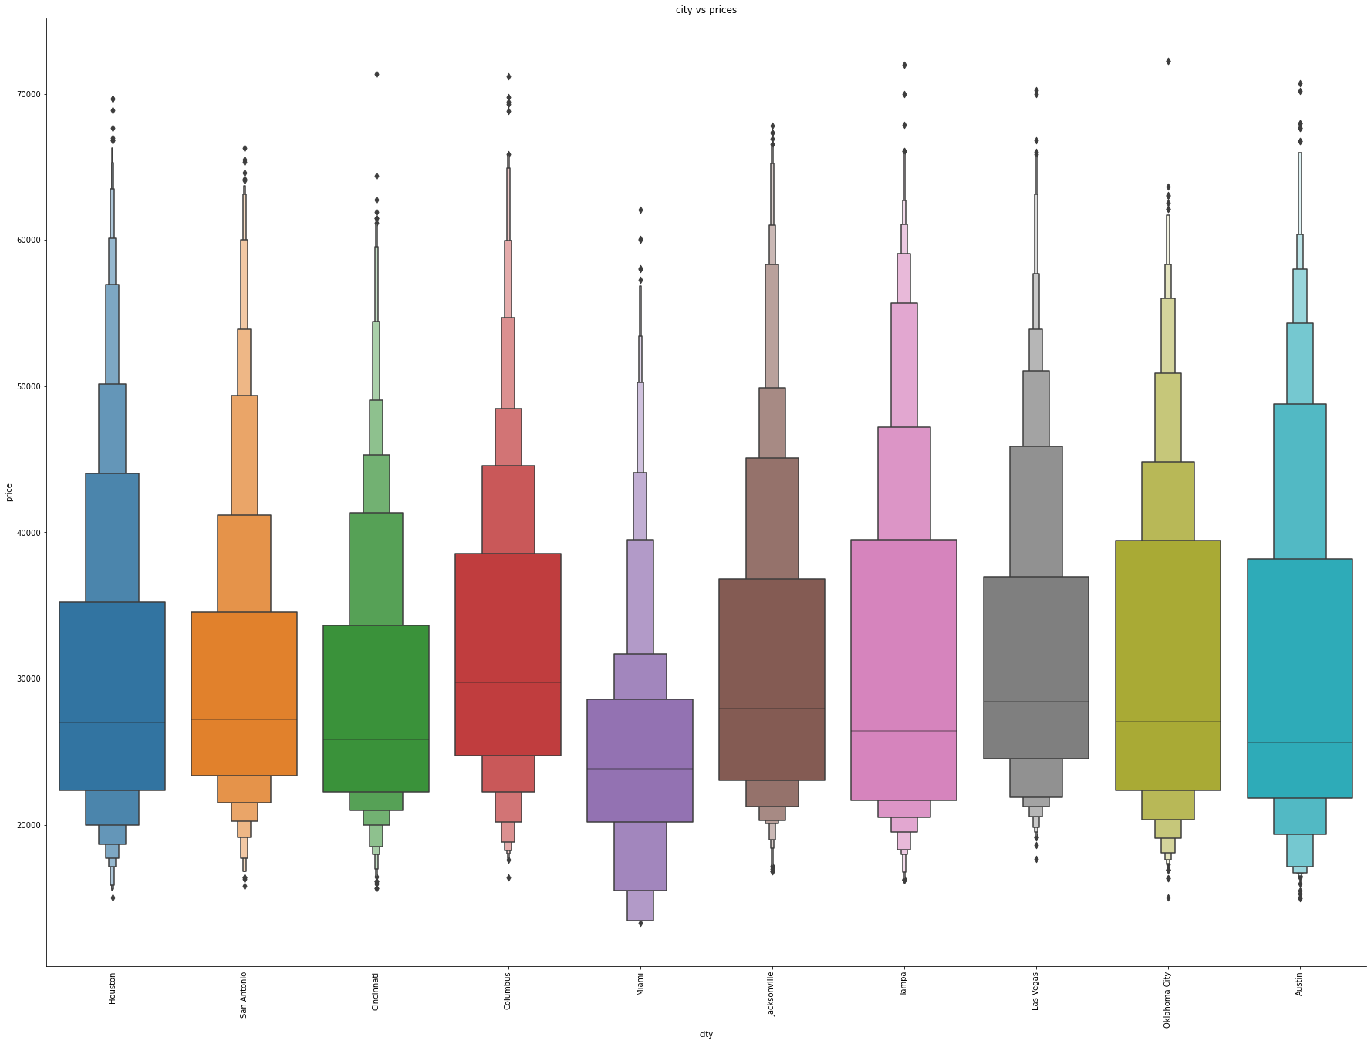

Slide 15
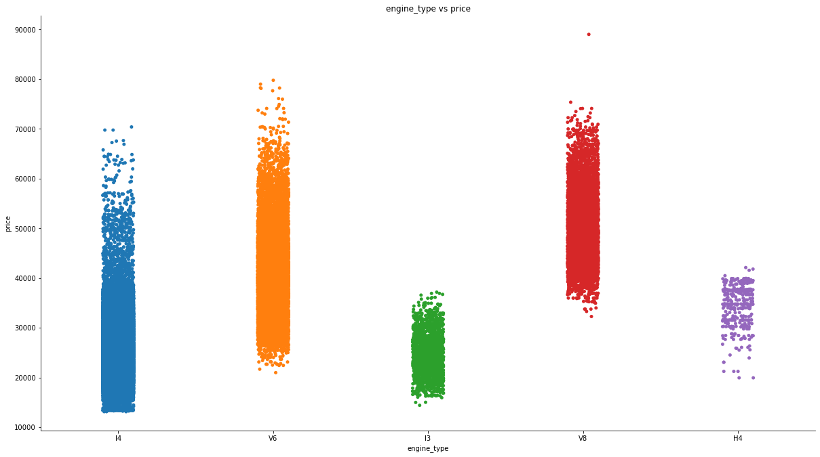

Slide 16
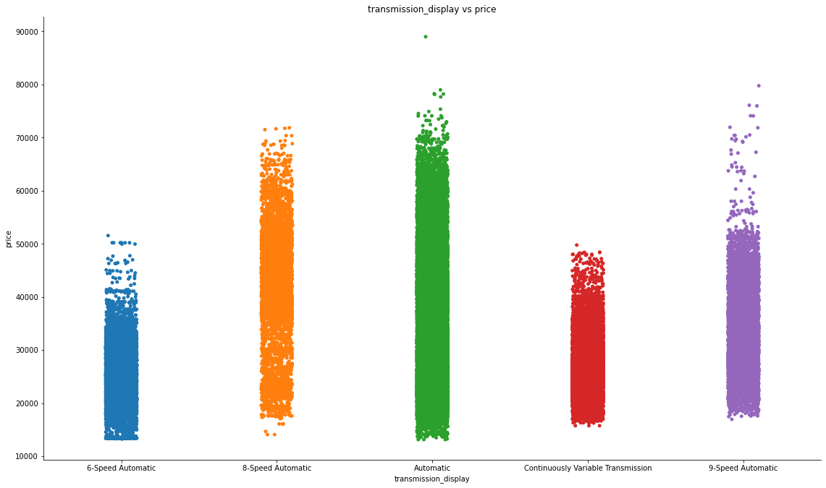

Slide 17
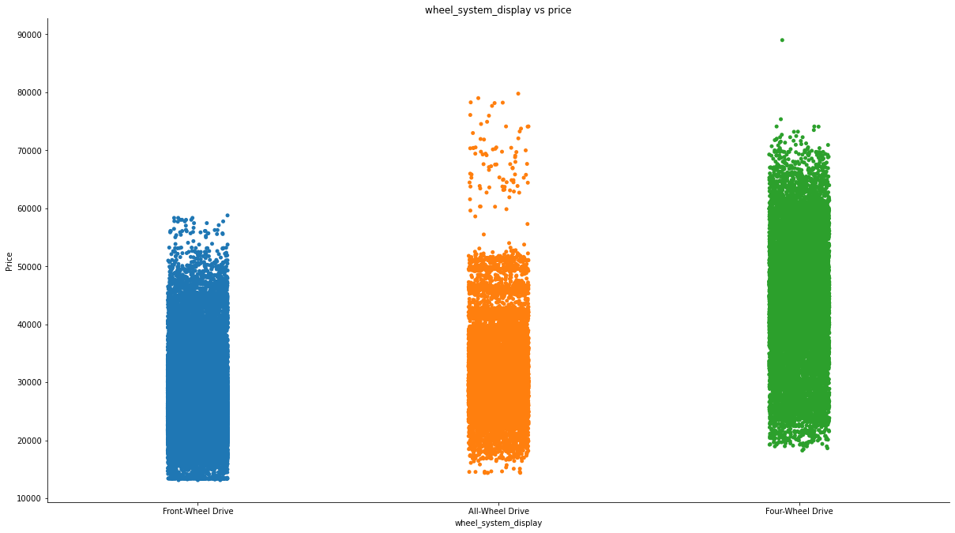

Slide 18
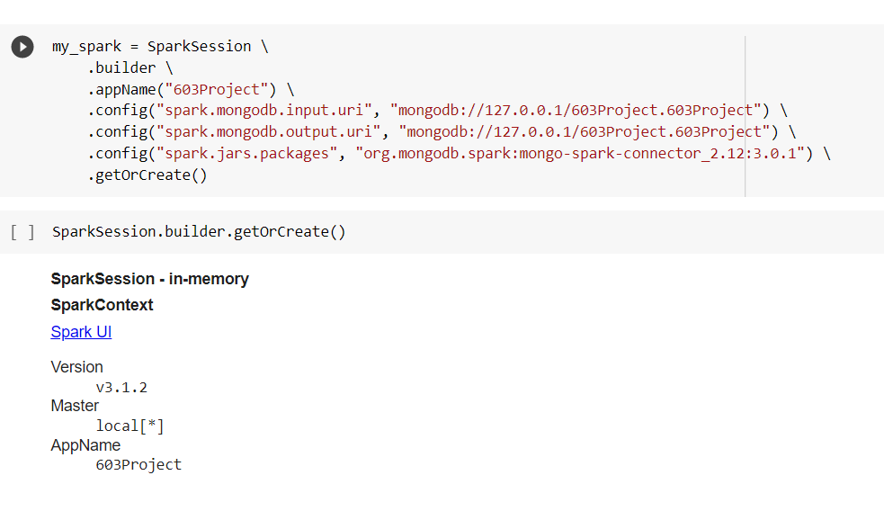
Loading data

Slide 19
Using ML
Linear Regression
Decision Tree
Random Forest

Slide 20
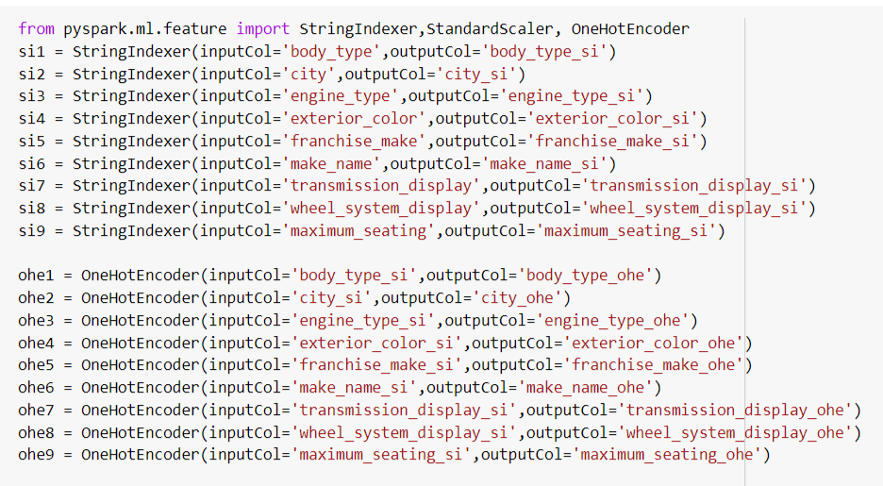
Data Preprocessing

Slide 21
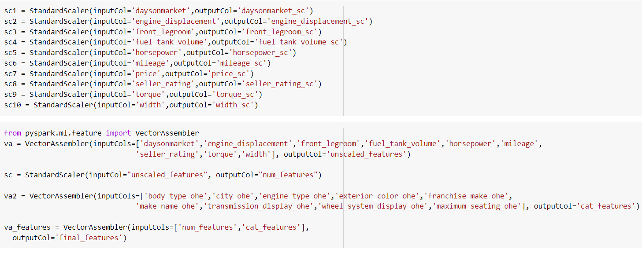
Data Preprocessing

Slide 22
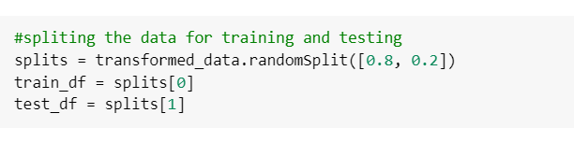
Split data
Train
Test

Slide 23
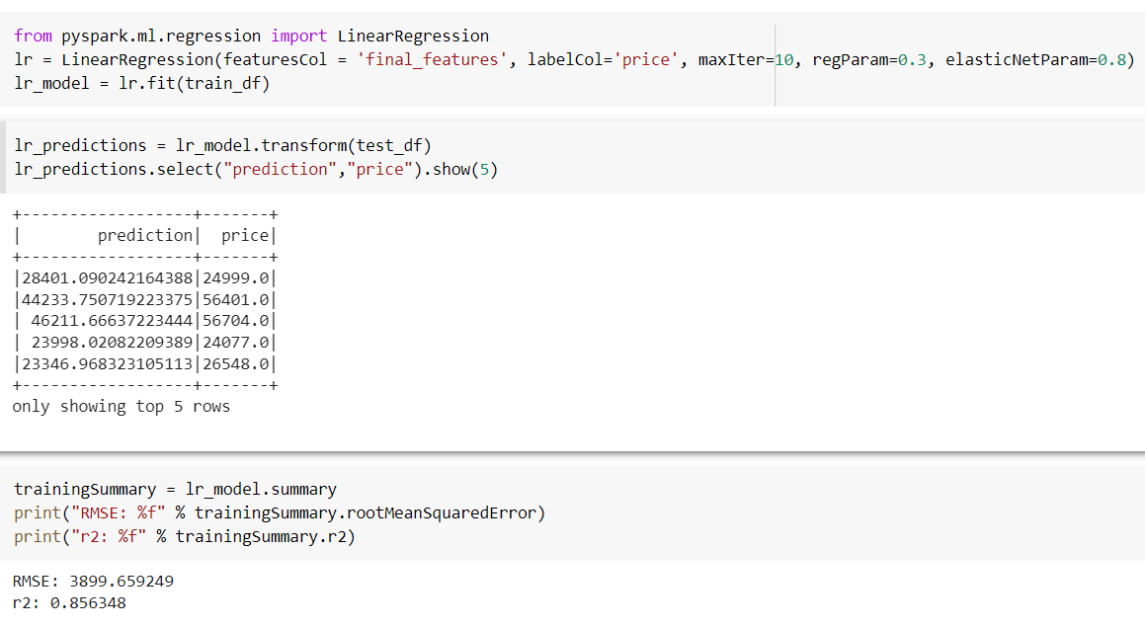
Linear Regressor

Slide 24
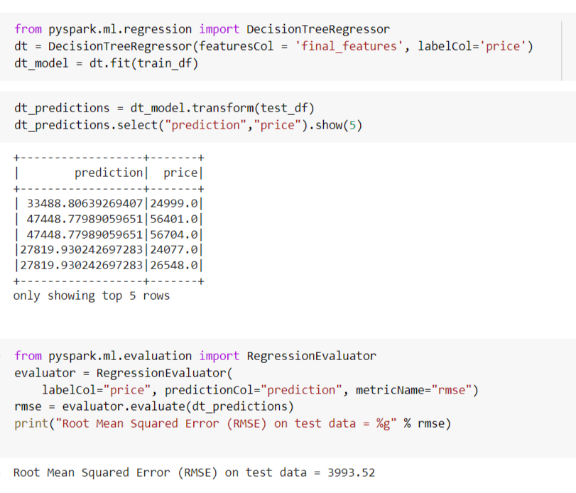
Decision Tree Regressor

Slide 25
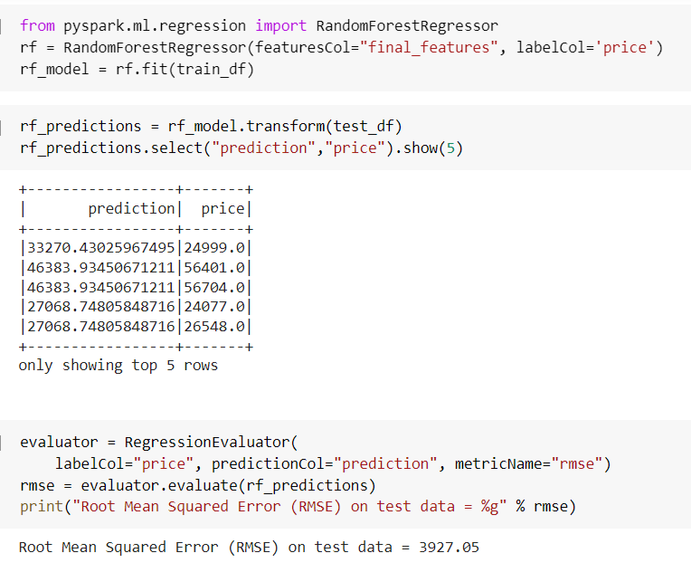
Random Forest Regressor

Slide 26
Model Evaluation
Model Name | Model RMSE | Model R-Square
Linear Regression | 3896.91 | 0.85
Decision Tree Regression | 3939.51 | 0.85
Random Forest Regression | 3852.86 | 0.86

Slide 27
Conclusion and Learnings
Our Solution can help visualize defined objectives and handles data loads through the power of distributed clusters.
Our Regression Models designed using Spark MLlib can predict the car price with a RMSE of $3850 .
Learnt about the Stack of bigdata tools and their power in Streaming and batch-processing of data.
Especially the applications of Pyspark considering the growing support for Python.

Slide 28
Thank you

